Slide 1
Our datasets
Prism
Prism.treat
Prism.cl
Prism.exp
Prism.cnv
Prism.snv
Prism. Achilles

Slide 2
Prism

Slide 3
Prism.treat
Prism.cl
Data frame
Information about the treatment's characteristics
11,168 treatments (rows) & 11 aspects treatments (columns)
Example: Dose, Name, moA, Target,
→ Explore relationships between treatment properties and treatment response
Date frame
Information about the cell line's characteristics
481 cell lines (rows) & 29 information aspects (columns)
Example: linage (subtype), disease (subtype)
→ Stratification of cell lines:
→ Relationship between gastric cell line characteristics and treatment response

Slide 4
Prism.treat
Prism.cl
Information providers
Context and additional information that can be used to explore relationships with other datasets (such as PRISM, PRISM.exp, or PRISM.cnv

Slide 5
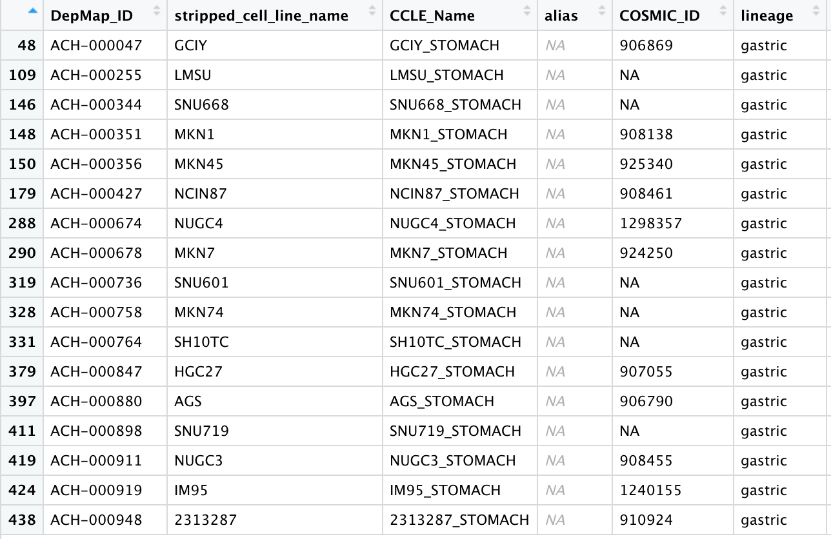
Prism.cl
What did we do so far?
→ gastric.cancer.cellline

Slide 6
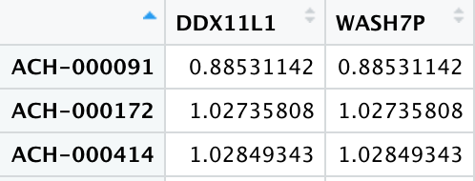
Prism.cnv
Prism.snv
Data frame
Gene copy (CN) values per gene
481 cell lines (rows) & 27562 genes (columns)
Normal: CN = 2
Amplification: CN < 2
Deletion: CN > 2
Identify genes with frequent copy number alterations (amplifications or deletions) in gastric cancer cell lines
Data frame
Mutations observed in a sample
452,695 genes (rows) & 32 information about mutation (columns)
Example: Start/End position, classification, cell line, functional effect
Identify frequently mutated genes in gastric cancer cell lines
Notes:
PRISM.cnv and PRISM.snv datasets are information providers that offer additional layers of complexity to the analysis
For further research as the primary
For instance, copy number variations (CNVs) and single nucleotide variants (SNVs) can influence how a cell responds to a particular treatment. Understanding these genomic alterations can help explain why some treatments work for certain cell lines and not for others.
For example, a specific mutation may correlate with a positive response to a certain drug, suggesting that the drug could be repurposed for patients with that mutation.

Slide 7
Prism.exp

Slide 8
Prism.achilles

Slide 9
Our Strategy
Filter gastric cancer cell lines:
Analyse treatment response
Investigate treatment properties
Group treatments based on properties
Validate findings
Identify effective treatments for subtypes
Investigate gastric cancer subtypes
Main objective:
Identifying potential gastric cancer treatments and grouping them into subgroups based on various properties
Notes:
main objective: identifying potential gastric cancer treatments and grouping them into subgroups based on various properties:
Filter gastric cancer cell lines: From the PRISM.cl dataset, filter the cell lines that are specific to gastric cancer based on lineage.
Analyisis treatment response: Extract treatment response data for the gastric cancer cell lines from the PRISM dataset. Perform clustering analysis or other dimensionality reduction to group treatments with similar response profiles across these gastric cancer cell lines.
Investigate treatment properties: Merge the PRISM.treat dataset with the treatment response data for gastric cancer cell lines. This will provide information on the mechanism of action, target molecule, and other properties of the treatments.
Group treatments based on properties: Perform clustering or other dimensionality reduction techniques to group treatments with similar properties, such as target molecule, mechanism of action, or pathway.
Identifying genetic markers that are correlated with a effectiv drug response in cancer cell lines
Find effective treatment for gastric cancer based on gene expression
Investigate gastric cancer subtypes: Cluster gastric cancer cell lines based on their gene expression (PRISM.exp), copy number variation (PRISM.cnv), or mutation (PRISM.snv) profiles to identify distinct gastric cancer subtypes.
Identify effective treatments for subtypes: Analyze the relationship between treatment response and gastric cancer subtype cell lines. To identify which treatments are more effective for specific gastric cancer subtypes.
Validate findings: Use external databases or literature to validate your findings on the effectiveness of the identified treatments for gastric cancer.

